Slide 1
Sentiment Analysis of Car and Hotel Reviews
using Naive Bayes, Logistic Regression, and
Random Forest
Memoona Shah

Slide 2
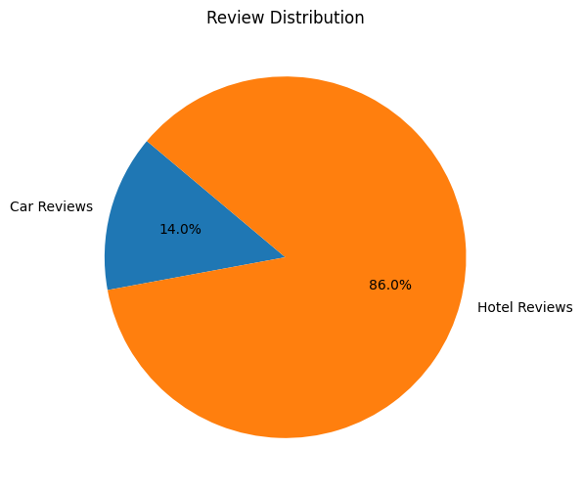
About the Dataset
Car Reviews (Total ~42,230):
Time Period: 2007, 2008, 2009.
Data Fields: Dates, authors, favorites, full textual reviews.
Organization:model years (2007, 2008, 2009
Hotel Reviews (Total ~259,000):
Locations: 10 cities including Dubai, New York, London.
Data Fields: Date, review title, full review.

Slide 3
Project Overview
Models: Naive Bayes, Logistic Regression, Random Forest.
Feature representation techniques: CountVectorisor and TF-IDF
Labeling Techniques: Vader Lexicon, affin lexicon and text blob library
Metrics: Comparative Analysis based on f1-score and Accuracy

Slide 4
Initial Data Processing
Data Integration: Extracted and standardized reviews data from XML files for cars and hotels, creating CSVs and merging them into cohesive datasets.
Exploratory Analysis: Conducted initial analysis on the integrated car dataset, visualizing key statistics and sentiment distribution using Python libraries.

Slide 5
Data Cleaning
Combined 'text' and 'favorite' columns in cars dataset
Handling the missing values
Text Normalization and Cleaning:
Removal of HTML tags, special characters, and uncommon symbols.
Stripping extra white spaces and trimming leading/trailing spaces.
Lowercasing all text for uniformity.
Expanding contractions to their full form (e.g., "don't" to "do not").
Preserving important negations by excluding them from stop words removal.
Stemming words to their root form.

Slide 6
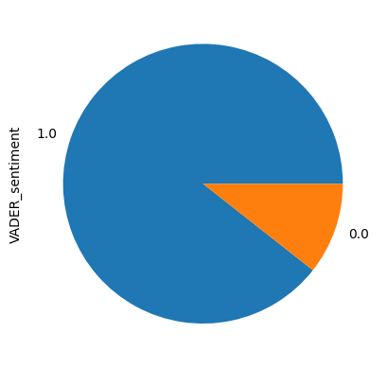
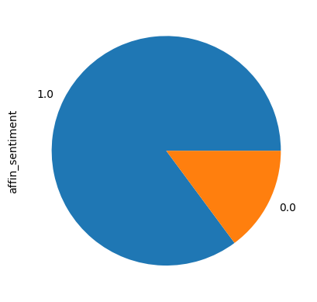
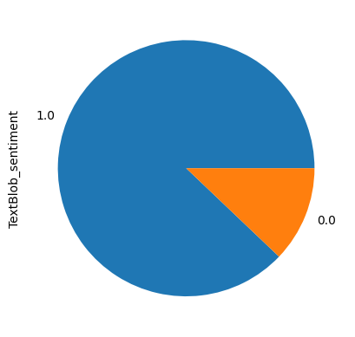
Data Labeling
Used NLTK's VADER lexicon for sentiment analysis on hotels and cars datasets.
Categorized sentiments as positive (≥ 0.5) or negative (< 0.5).
Hotels dataset: 225,452 positive and 26,932 negative sentiments, resulting in 250,759 clean entries.

Slide 7
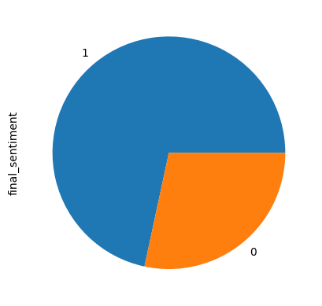
Data Labeling
We also did:
AFINN lexicon for sentiment labeling
TextBlob library for sentiment labeling
Employed majority voting from VADER, AFINN, and TextBlob to generate a unified 'final_sentiment'.

Slide 8
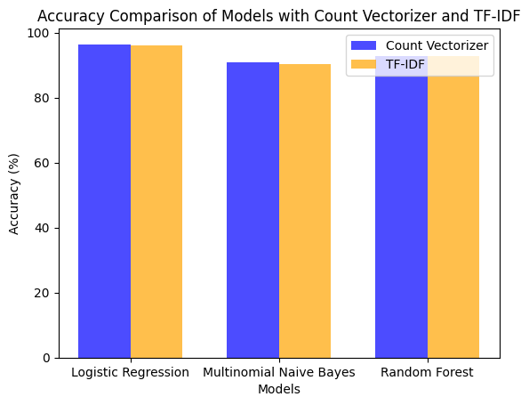
Initial Experiment - no gridsearch or cross validation
Count Vectorisor:
Logistic Regression Accuracy = 96.42%
Multinomial Naive Baye Accuracy = 90.80%
Random forest Accuracy = 92.70
TF-IDF:
Logistic Regression Accuracy = 96.12%
Multinomial Naive Baye Accuracy = 90.28%
Random forest Accuracy = 92.67%

Slide 9
Gridsearch and cross- validation
Optimization for Performance:The grid search for hyperparameters tuning for both vectorizers and classifiers.
F1-Macro Evaluation Metric: The grid search evaluates model performance using the F1-macro score.
Notes:
For Multinomial Naive Bayes, a grid search is done over the alpha values.
Logistic Regression and Random Forest are run with alpha of parameters.
n-gram ranges and analyzer types for vectorizers
smoothing factors for Multinomial Naive Bayes
maximum iteration limits for Logistic Regression.

Slide 10
Gridsearch and cross- validation
Cross-Validation for Robustness:
robustly evaluate each parameter combination's performance
reduce the risk of overfitting
ensure generalization to unseen data.

Slide 11
Model Performances on cars data
Model | Parameters (Count Vectorizer) | F1-macro (Count Vectorizer) | Accuracy (Count Vectorizer) | Parameters (TF-IDF) | F1-macro (TF-IDF) | Accuracy (TF-IDF)
Multinomial Naive Bayes | ngram_range=(1,2), analyzer=word, alpha=0.3421 | 0.9739 | 0.9495 | ngram_range=(1,2), analyzer=word, alpha=0.0263 | 0.9730 | 0.9476
Logistic Regression | ngram_range=(1,2), analyzer=word | 0.9831 | 0.9679 | Default (ngram_range=DEFAULT, analyzer=DEFAULT) | 0.9735 | 0.9493
Random Forest | ngram_range=(1,2), analyzer=char | 0.9714 | 0.9444 | ngram_range=(1,3), analyzer=char | 0.9663 | 0.9349

Slide 12
Model Performances on Hotels data
Model | Parameters (Count Vectorizer) | F1-macro (Count Vectorizer) | Accuracy (Count Vectorizer) | Parameters (TF-IDF) | F1-macro (TF-IDF) | Accuracy (TF-IDF)
Multinomial Naive Bayes | ngram_range=(1,2), analyzer=word, alpha=0.5 | 0.9584 | 0.9268 | ngram_range=(1,1), analyzer=word, alpha=0.0263 | 0.9689 | 0.9402
Logistic Regression | ngram_range=(1,2), analyzer=word | 0.9838 | 0.9722 | Default (ngram_range=DEFAULT, analyzer=DEFAULT) | 0.9735 | 0.9493
Random Forest | ngram_range=(1,3), analyzer=char | 0.9518 | 0.9142 | ngram_range=(1,3), analyzer=char | 0.9663 | 0.9349

Slide 13
Table 2 (a) : CountVectorizer - Combined Data
Model | Parameters | F1-macro | Accuracy
Multinomial Naive Bayes | ngram_range=(1,2), analyzer=word, alpha=0.0263 | 0.9584 | 0.9395
Logistic Regression | ngram_range=(1,2), analyzer=word | 0.9869 | 0.9812
Random Forest | ngram_range=(1,2), analyzer=char | 0.9577 | 0.9379

Slide 14
Table 2 (b): TF-IDF - Combined Data
Model | Parameters | F1-macro | Accuracy
Multinomial Naive Bayes | ngram_range=(1,2), analyzer=word, alpha=0.0263 | 0.9640 | 0.9468
Logistic Regression | ngram_range=(1,2), analyzer=word | 0.9734 | 0.9492
Random Forest | ngram_range=(1,2), analyzer=char | 0.8801 | 0.8049

Slide 15
Table: Best and worst Performance with CountVectorizer and TF-IDF
Model | CountVectorizer | TF-IDF
Logistic Regression | F1-macro: 0.9734 Accuracy: 0.9492 | F1-macro: 0.9869 Accuracy: 0.9812
Random Forest | F1-macro: 0.9577 Accuracy: 0.9379 | F1-macro: 0.8801, Accuracy: 0.8049

